Slide 2
Expedia H-1B Cap Webinar
January 29, 2018

Slide 3


With You ToDAY:
Delya Ghosh
Partner
Margret Gonzales
Associate

Slide 4
Agenda h-1B BASICS What is the H-1B Cap? Why is there A Lottery and How does it Work? What TO EXPECT IF THE H-1B Petition iS /IS NOT selected in LotterY H-1B CAP 2017: What WE Learned In the News… trUE Or false? Questions

Slide 5

What is H-1B status?
What is H-1B status?
Reserved for professionals working in “Specialty Occupations” – positions requiring at least a Bachelor’s degree in the specialty.
Company sponsored visa
By far the most popular employment-based non-immigrant status overall; most common status at Expedia.
Available for a maximum of six years, with extensions available based on green card process.
Reserved for professionals working in “Specialty Occupations” – positions requiring at least a Bachelor’s degree in the specialty.
By far the most popular employment-based non-immigrant status overall; most common status at Expedia.
Available for a maximum of six years, with extensions available based on green card process.

Slide 6
Why File an H-1B? ExPEDIA WANTS TO ENSURE CONTINUED WORK Authorization for its Employees:
Visa | Limitation
F-1 | Limited to 12 to 36 months of work authorization
J-1 | Limited to program length
L-1 | Limited to 5 or 7 years of work authorization
TN & E-3 | Non-immigrant intent and treaty based
H-4 & L-2 | Limited to work authorization through spouse
Expedia wants to ensure continued work authorization for its employees:

Slide 7
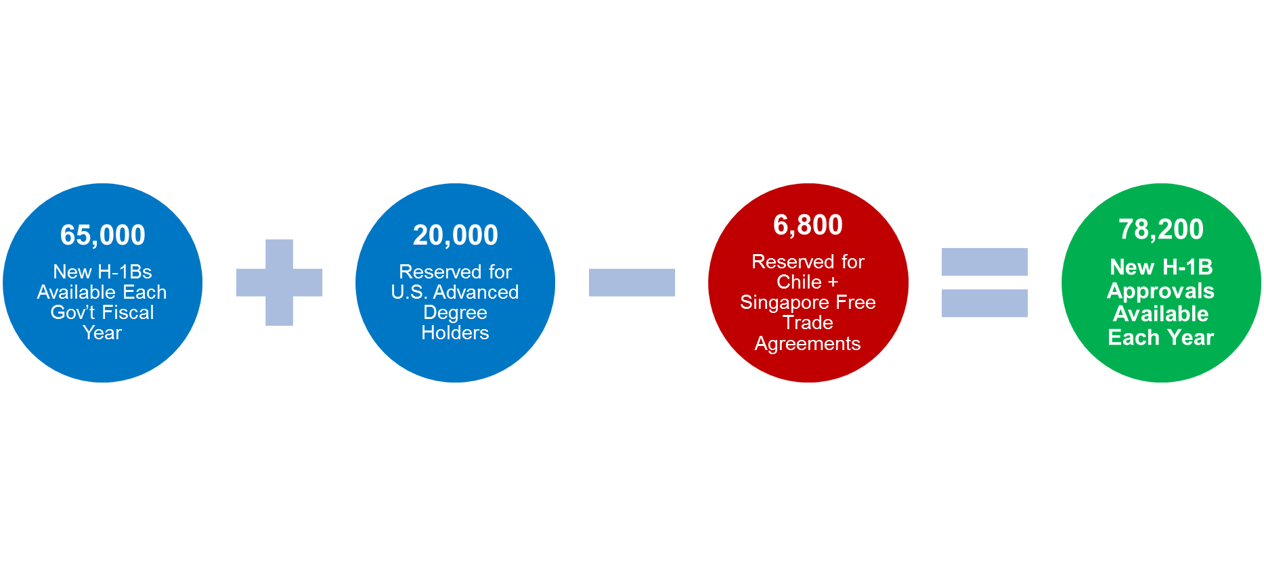
What is the H-1B cap?
There is an annual numerical limitation on new H-1Bs.

Slide 8

Why is there an H-1B lottery? Demand for H-1B visas has exceeded supply, creating a need for a lottery
2013
2015
2016
2017
172,000 petitions filed
233,000 petitions filed
236,000 petitions filed
199,000 petitions filed
37% chance of selection nationwide
36% chance of selection nationwide
49% chance of selection nationwide
2014
124,000 petitions filed
69% chance of selection nationwide
43% chance of selection nationwide
2018
Expect similar trends

Slide 9

How Does the Lottery Work?
USCIS accepts petitions for the new fiscal year the week of April 1^{st .} This year the first day falls on April 2nd.
If cap is exceeded in first 5 business days, USCIS will randomly select petitions for processing
Lottery is random and computer-generated
Advanced Degree Holder cap (20K) is held first
General H-1B cap (65K) held after
If selected, H-1B will receive receipt notice, and continue processing
If H-1B is not selected, no receipt is issued, and the petition is mailed back

Slide 10
H-1B filing options – what’s the difference?
 | Change of Status | Consular Process
Who has a choice? | Default H-1B filing option for all employees | EEs in L-1/E-3/TN status may be considered if spouse is working, or may work. EEs who absolutely must travel in April to May timeframe may need to choose consular.
Travel restrictions during cap? | Must be physically present in the US on April 2nd . Must remain in US until case is adjudicated (approx. May). | None
What happens on October 1st (if the petition is selected and approved)? | Automatically change status to H-1B on October 1st if physically in the US. For international travel after October 1st, must secure an H-1B visa stamp abroad before returning to the US. Best practice: apply for visa stamp in home country. | Nothing happens on October 1st. Current visa status stays the same. Can activate H-1B before current work authorization expires/maxes out. To activate H-1B, must travel to US Consulate abroad, apply for a visa stamp, and re-enter US. Best practice: apply in home country.

Slide 11
What happens if H-1B petition is selected in lottery?
Notification | BAL will notify EE as soon as lottery selection confirmed, likely mid-April. BAL will also notify EE when H-1B approval notice received.
Timing | Expedia files all cases Premium Processing, typically allowing for results in 15 days. However, USCIS will likely suspend Premium Processing for a few weeks in April. USCIS case review likely to begin mid-to late April. Approval notices expected between May and June. USCIS has signaled it does not intend to suspend premium processing for a lengthy period as it did last summer.
H-1B Work Authorization | If approved, the H-1B is valid from October 1. If EE is outside of US, the earliest EE can enter US in H-1B status is September 21. Work authorization will begin only on October 1.
Work Authorization if Current Status Expires Before 9/30 | Expedia Immigration HR will partner closely with manager, HRBP, and EE on contingency plans if needed. Two Options for F-1s: Cap Gap authorization through DSO. 24-month OPT STEM extension if degree in designated STEM field and based at an Expedia E-Verify site. BAL assists Expedia employees with STEM training plans and Evaluations.
International Travel Restrictions | EE cannot travel outside US while petition is pending if filed as “change of status”. Travel while in Cap Gap or with expired OPT and STEM pending carries risk.

Slide 12
What happens if H-1B petition is NOT selected in lottery?
Can apply in future H-1B lottery
Notification | BAL will notify employee when petition returned from USCIS.
Timing | BAL will not definitively know that the H-1B petition was not selected until USCIS returns the H-1B filing, likely July or August. Indicators if not selected by early May. BAL will send updates on anticipated outcomes at that time.
If Current Work Authorization Expires Before 4/1/19 | BAL will track work authorization expiration, and proactively reach out to assist with extension process. BAL assists Expedia employees with STEM training plans and Evaluations.

Slide 13
What happens if H-1B petition is NOT selected in lottery?
Last chance at the H-1B lottery
Notification | If this is your last chance at the H-1B lottery before running out of US work authorization, BAL and Expedia Immigration will be identifying these cases and reaching out about contingency plans.
Timing | Expect to receive update on selection indicators by early May.
Before Expiration of Work Authorization | Employee may have to depart the US when work authorization expires. Expedia Immigration will partner with employee, manager, and HRBP in finalizing contingency plans

Slide 14
H-1B CAP 2017: What WE Learned
What we learned:
Increased overall scrutiny
Requests for Evidence questioning specialty occupation, employee qualifications, and maintenance of status
Denials for certain occupations (Expedia continues to have a very low rate of denial)
How Expedia is pro-actively addressing these issues for 2018:
Providing more detailed job descriptions (i.e. projects, technologies, etc. utilized in performance of your duties)
Securing detailed employment verification letters if degree not clearly related to position
Providing additional maintenance of status documents

Slide 15
H-1b (cap) In the News…
In April 2017, President Trump signed the “Buy American and Hire American” Executive Order (EO).
The EO directs gov’t agencies to prevent fraud and abuse in the immigration system.
The EO asks for reforms “to ensure that H-1B visas are awarded to the most-skilled or highest-paid” individuals
Expected Change | Will it impact this upcoming H-1B Cap filing?
DHS plans to propose a pre-registration system for cap-subject H-1B visa applicants. | No. May impact 2019 filings.
DHS will propose a rule to revise the definition of “specialty occupation” for H-1B eligibility . | No.

Slide 16

TRUE OR FALSE?
Applying with Premium Processing increases my odds of selection in the lottery. False
Having a US Master’s degree increases the odds of selection. True Having a PhD increase odds even more. False
H-1B petitions for certain positions more likely to be selected in the lottery. False
Expedia can file an H-1B petition on my behalf before I graduate from school. Maybe
Expedia can file more than one petition for me. False

Slide 17

Contacts
Delya Ghosh
Partner
dghosh@balglobal.com
+1 415 743 9694
Margret Gonzales
Associate
mgonzales@balglobal.com
+1 415 743 9622
Expedia Immigration
immigration@expedia.com

Slide 18


Questions

